Slide 1


Computer Organisation and Architecture
Chapter 5 – The Instruction Set Architecture

Slide 2
Chapter Contents
    Hardware Components of the Instruction Set Architecture
    ARC, A RISC Computer
    Pseudo-Operations
    Synthetic Instructions
    Examples of Assembly Language Programs
    Accessing Data in Memory—Addressing Modes

Slide 3
The Instruction Set Architecture
  • The Instruction Set Architecture (ISA) view of a machine corresponds to the machine and assembly language levels.
  • A compiler translates a high level language, which is architecture independent, into assembly language, which is architecture dependent.
  • An assembler translates assembly language programs into executable binary codes.
  • For fully compiled languages like C and Fortran, the binary codes are executed directly by the target machine. Java stops the translation at the byte code level. The Java virtual machine, which is at the assembly language level, interprets the byte codes (hardware implementations of the JVM also exist, in which Java byte codes are executed directly.)

Slide 4
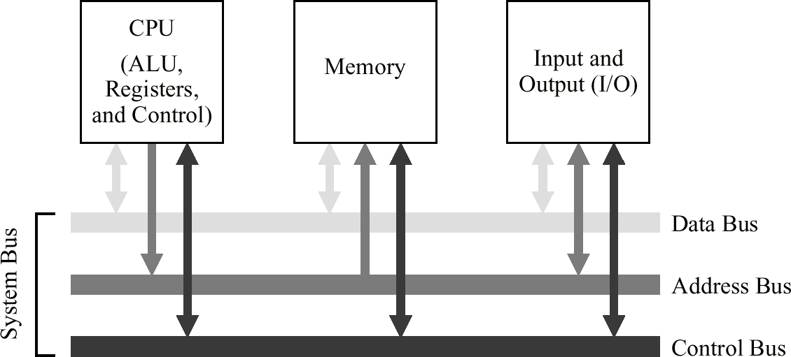
The System Bus Model of a Computer System, Revisited
  • A compiled program is copied from a hard disk to the memory. The CPU reads instructions and data from the memory, executes the instructions, and stores the results back into the memory.

Slide 5
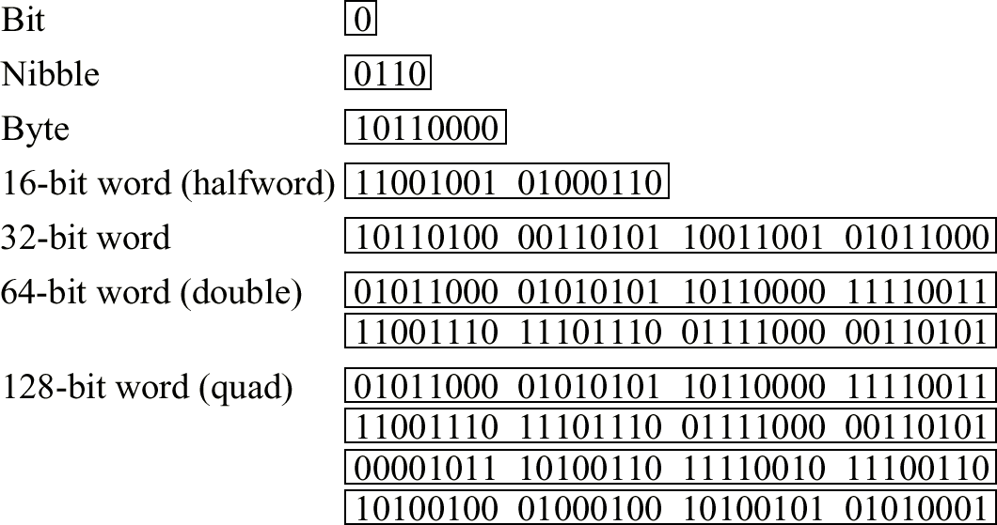
Common Data Type Sizes
  • A byte is composed of 8 bits. Two nibbles make up a byte.
  • Halfwords, words, doublewords, and quadwords are composed of bytes as shown below:

Slide 6
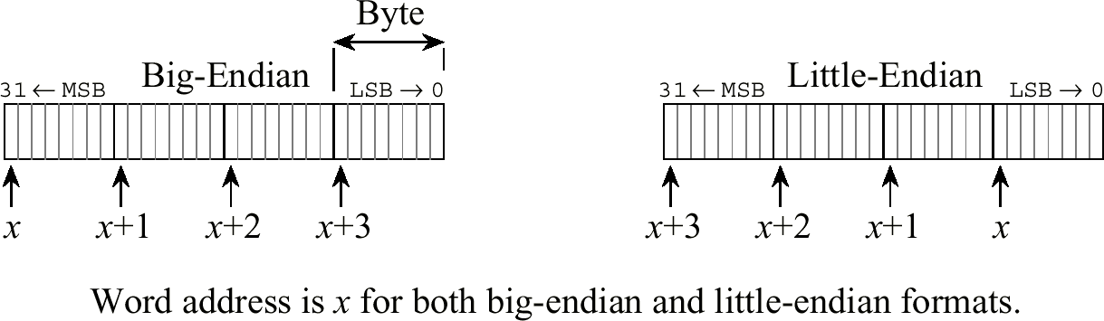
Big-Endian and Little-Endian Formats
  • In a byte-addressable machine, the smallest datum that can be referenced in memory is the byte. Multi-byte words are stored as a sequence of bytes, in which the address of the multi-byte word is the same as the byte of the word that has the lowest address.
  • When multi-byte words are used, two choices for the order in which the bytes are stored in memory are: most significant byte at lowest address, referred to as big-endian, or least significant byte stored at lowest address, referred to as little-endian.

Slide 7
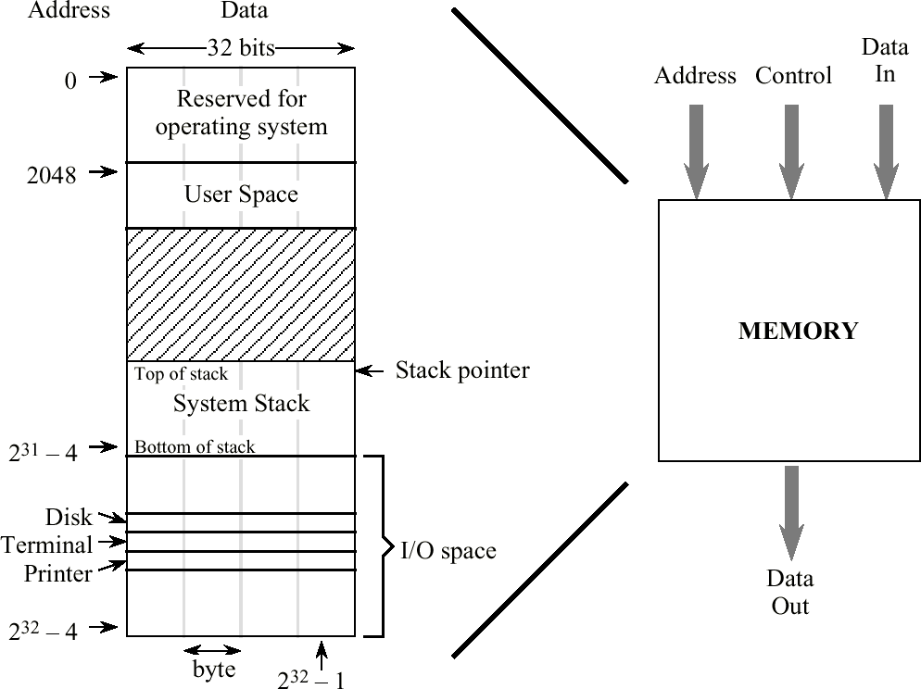
Memory Map for the ARC
  • Memory locations are arranged linearly in consecutive order. Each numbered location corresponds to an ARC word. The unique number that identifies each word is referred to as its address.

Slide 8
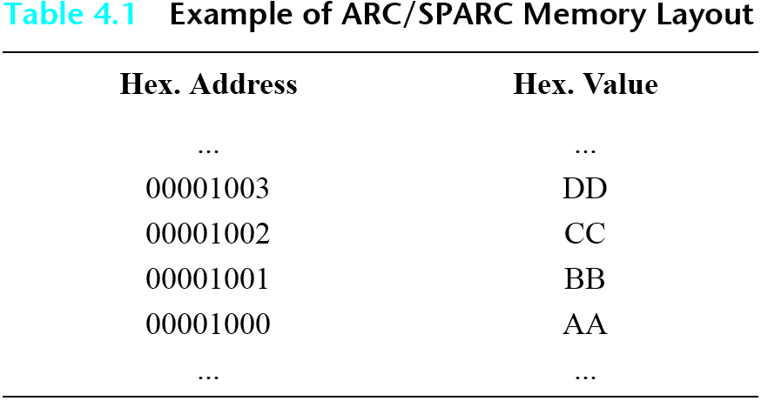
Example of ARC Memory Layout
  • The table illustrates both the distinction between an address and the data that is stored there, and the fact that ARC/SPARC is a big-endian machine. The table shows four bytes stored at consecutive addresses 00001000 to 00001003.
  • Thus the byte address 0x00001003 contains the byte 0xDD. Since this is a big-endian machine (the big end is stored at the lowest address) the word stored at address 0x00001000 is 0xAABBCCDD.

Slide 9
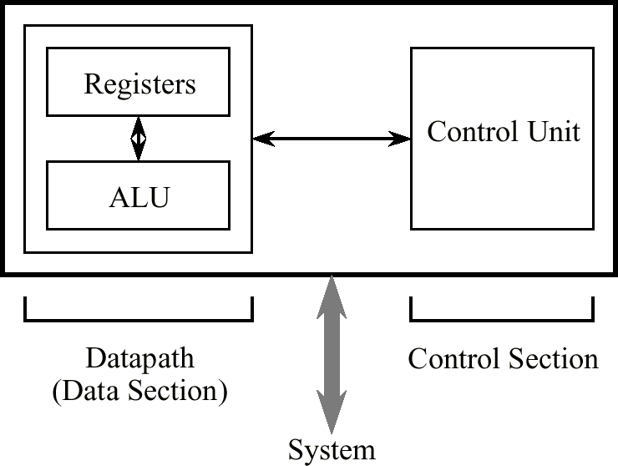
Abstract View of a CPU
  • The CPU consists of a data section containing registers and an ALU, and a control section, which interprets instructions and effects register transfers. The data section is also known as the datapath.

Slide 10
The Fetch-Execute Cycle
  • The steps that the control unit carries out in executing a program are:
  (1) Fetch the next instruction to be executed from memory.
  (2) Decode the opcode.
  (3) Read operand(s) from main memory, if any.
  (4) Execute the instruction and store results, if any.
  (5) Go to step 1.
  This is known as the fetch-execute cycle.

Slide 11
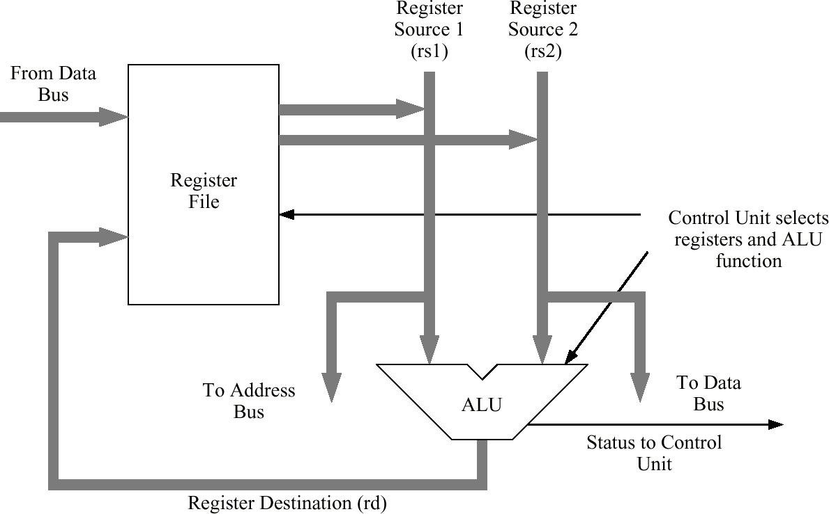
An Example Datapath
  • The ARC datapath is made up of a collection of registers known as the register file and the arithmetic and logic unit (ALU).

Slide 12
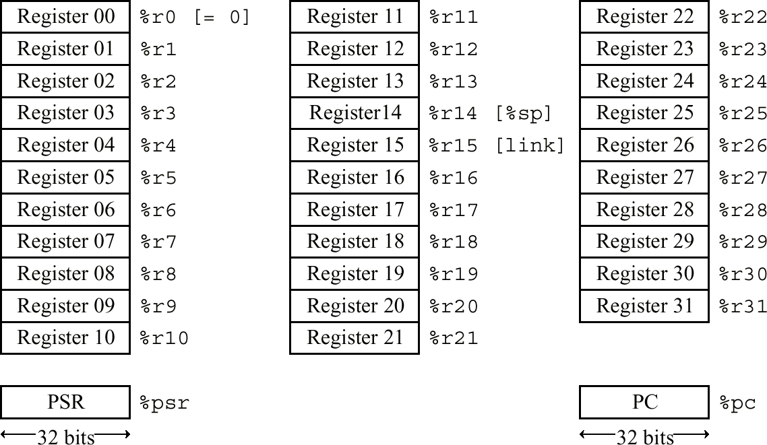
ARC User-Visible Registers

Slide 13
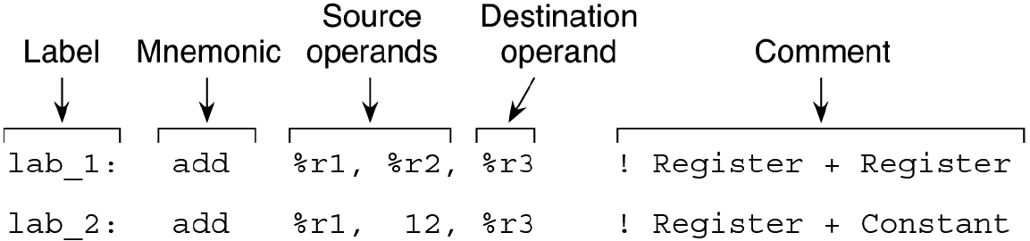
ARC Assembly Language Format
  • The ARC assembly language format is the same as the SPARC assembly language format.
  • This example shows the assembly language format for ARC (and SPARC) arithmetic and logic instructions.

Slide 14
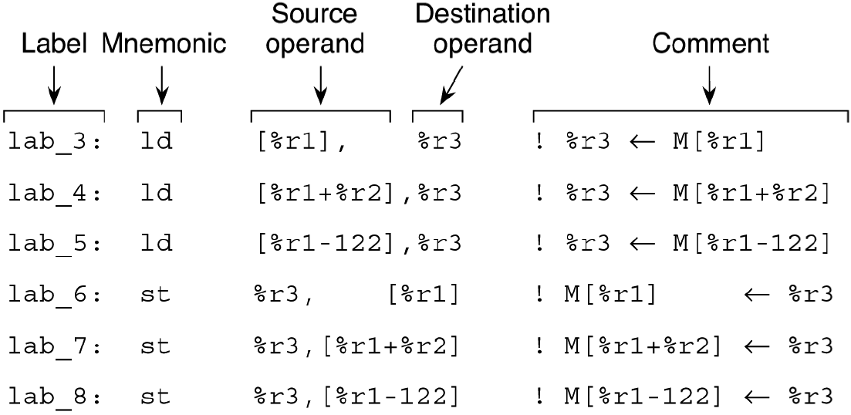
ARC Load / Store Format
  • This example shows the assembly language format for ARC load and store instructions.

Slide 15
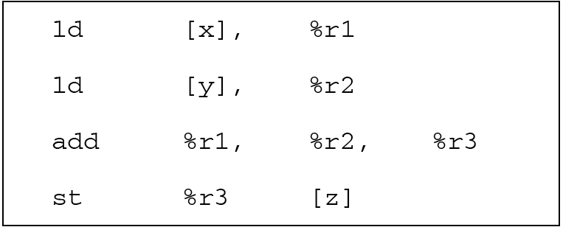
Simple Example: Add Two Numbers
  • The figure shows a simple program fragment using our ld, st, and add instructions. This fragment is equivalent to the C statement:
z = x + y;
  • Since ARC is a load-store machine, the code must first fetch the x and y operands from memory using ld instructions, and then perform the addition, and then store the result back into z using an st instruction.

Slide 16
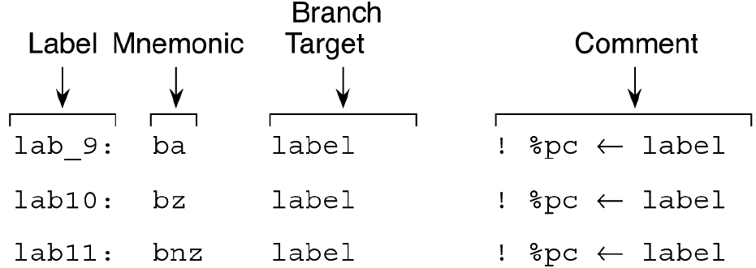
ARC Transfer of Control Sequence
  • This example shows the assembly language format for ARC branch instructions.

Slide 17
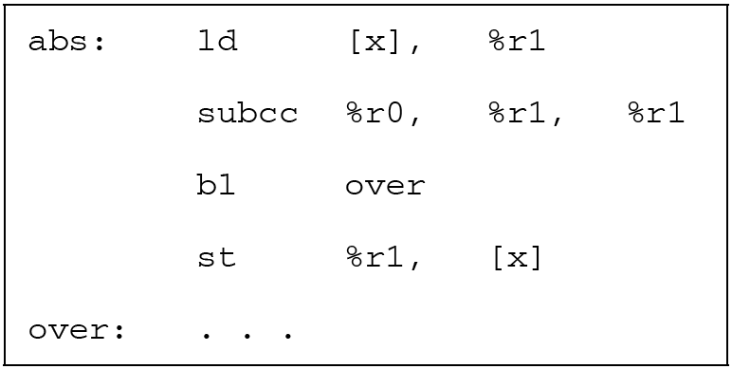
ARC Fragment that Computes the Absolute Value
  • As an example of using the ARC instruction types we have seen so far, consider the absolute value function, abs:
abs(x) := if (x < 0) then x = -x;
An ARC fragment to implement this is shown below:

Slide 18
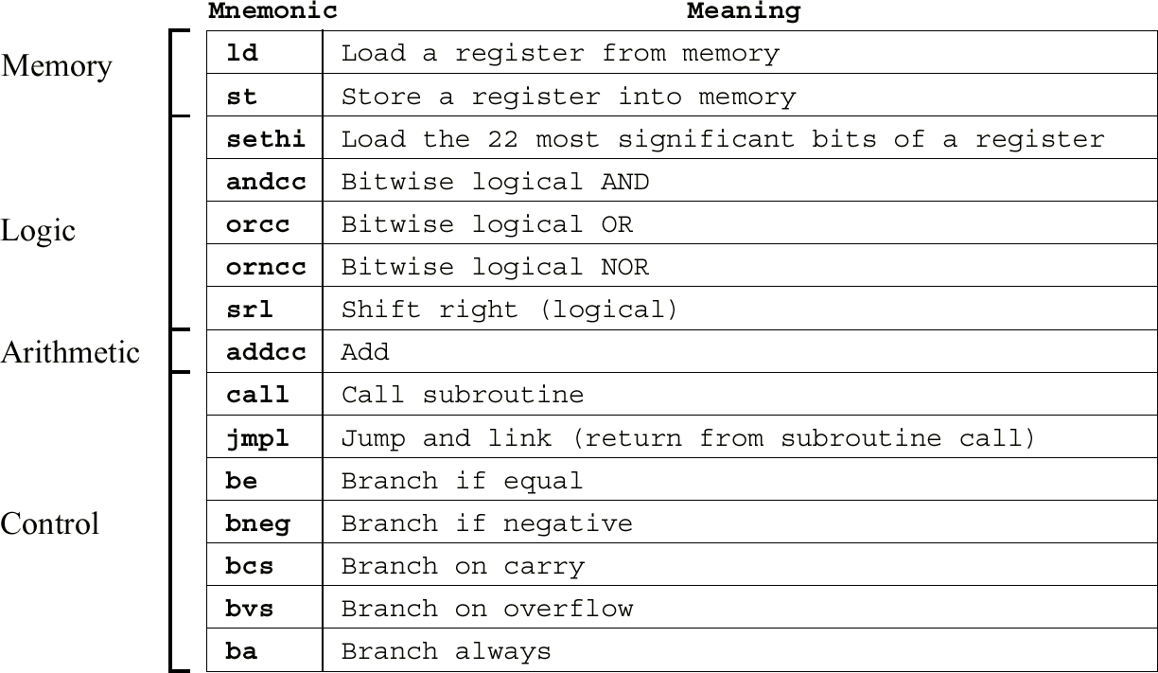
A Portion of the ARC ISA
  • The ARC ISA is a subset of the SPARC ISA. A portion of the ARC ISA is shown here.

Slide 19
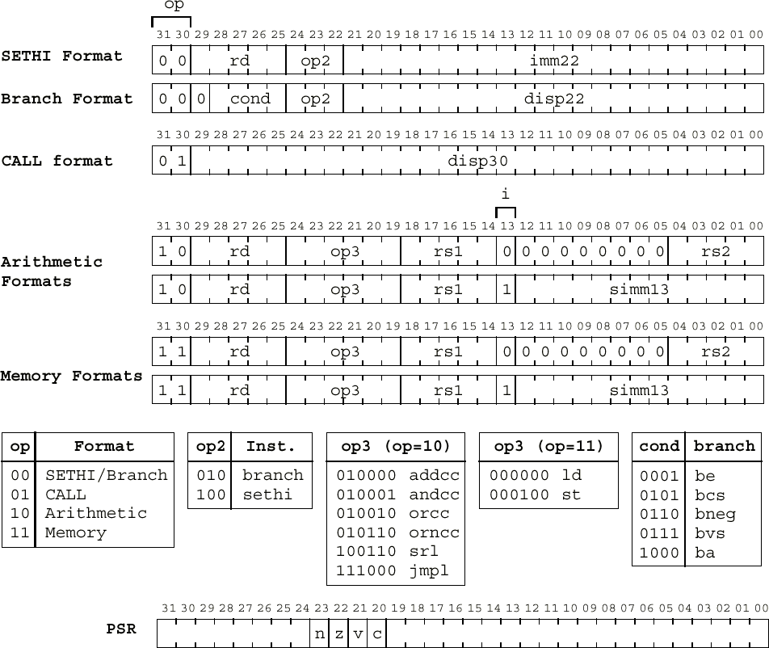
ARC Instruction and PSR Formats

Slide 20
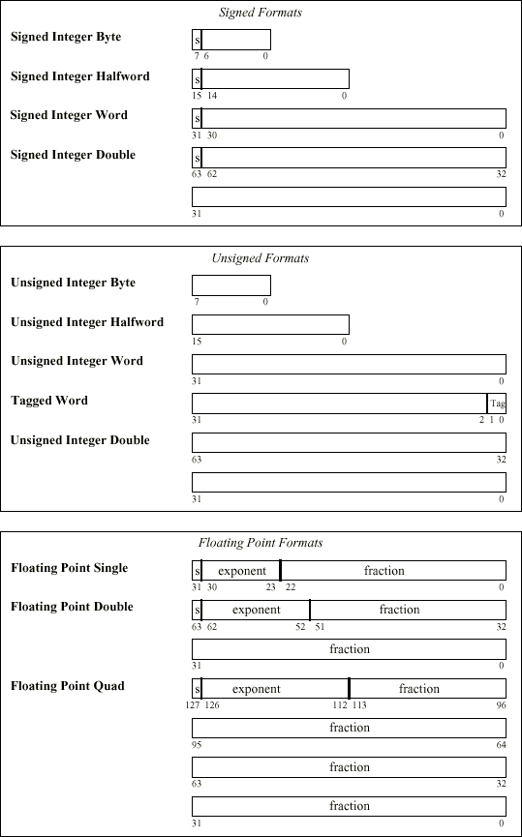
ARC Data Formats

Slide 21
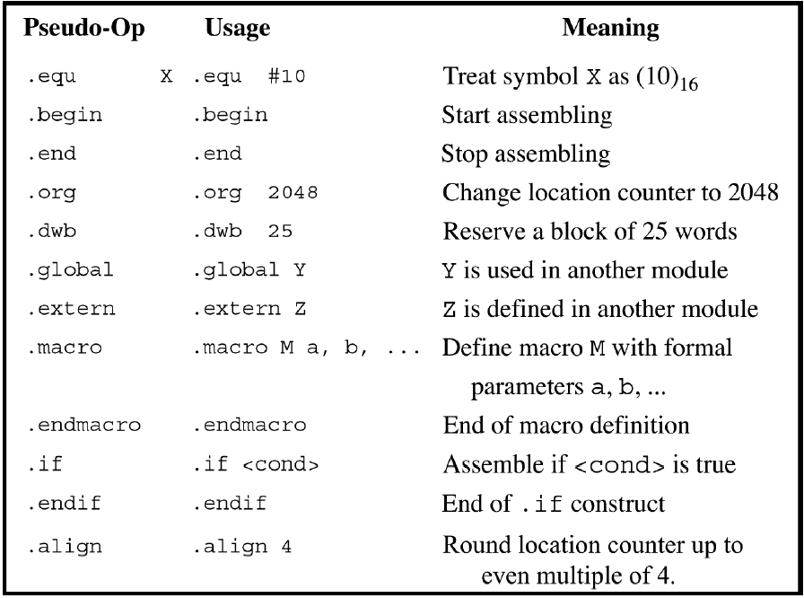
ARC Pseudo-Ops
  • Pseudo-ops are instructions to the assembler. They are not part of the ISA, but instruct the assembler to do an operation at assembly time.

Slide 22
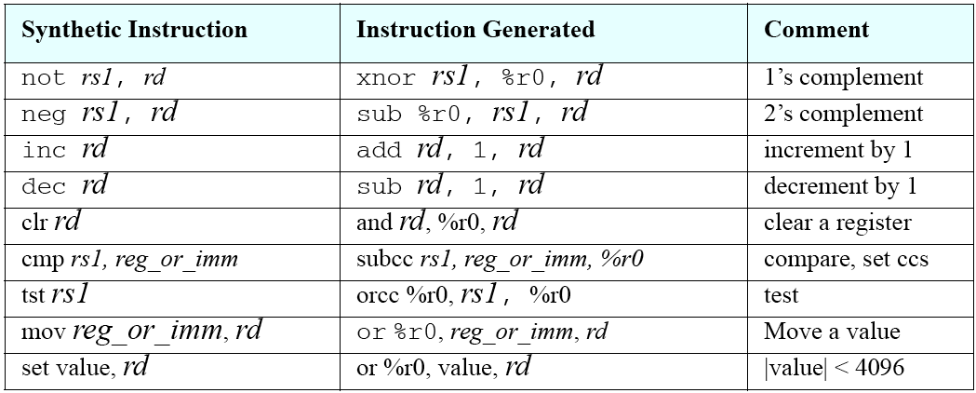
Synthetic Instructions
  • Many assemblers will accept synthetic instructions that are converted to actual machine-language instructions during assembly. The figure below shows some commonly used synthetic instructions.
  • Synthetic instructions are single instructions that replace single instructions, which are different from macros which are discussed later.

Slide 23
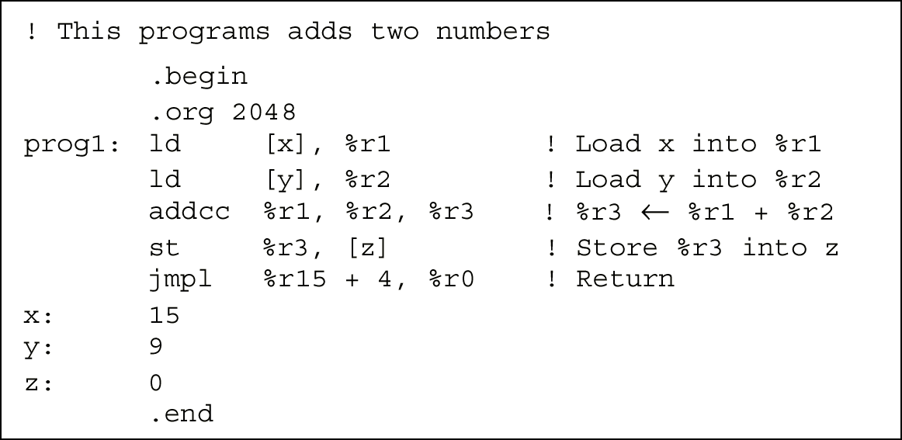
ARC Example Program
  • An ARC assembly language program adds two integers:

Slide 24
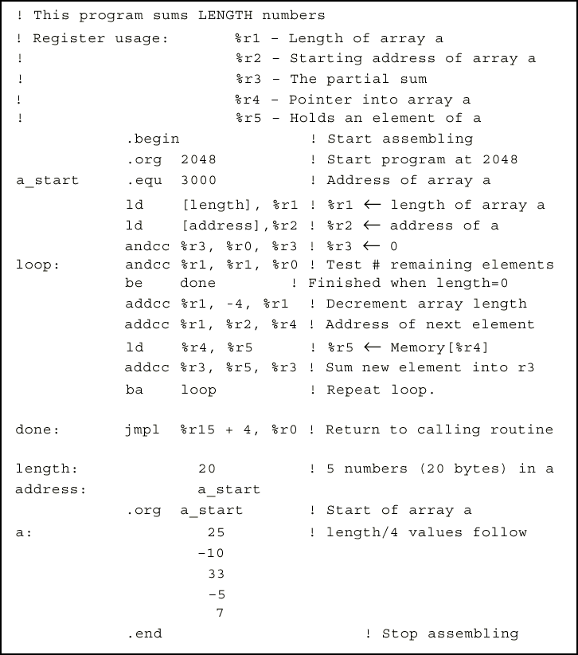
A More Complex Example Program
  • An ARC program sums five integers.

Slide 25
One, Two, Three-Address Machines
  • Consider how the C expression A = B*C + D might be evaluated by each of the one, two, and three-address instruction types.
  • Assumptions: Addresses and data words are two bytes in size. Opcodes are 1 byte in size. Operands are moved to and from memory one word (two bytes) at a time.
  • Three-Address Instructions: In a three-address instruction, the expression A = B*C + D might be coded as:
  mult B, C, A
  add D, A, A
  which means multiply B by C and store the result at A. (The mult and add operations are generic; they are not ARC instructions.) Then, add D to A and store the result at address A. The program size is 7×2 = 14 bytes. Memory traffic is 14 + 2×(2×3) = 26 bytes.

Slide 26
One, Two, Three-Address Machines
  • Two Address Instructions: In a two-address instruction, one of the operands is overwritten by the result. Here, the code for the expression A = B*C + D is:
  load B, A
  mult C, A
  add D, A
  The program size is now 3×(1+2×2) or 15 bytes. Memory traffic is 15 + 2×2 + 2×2×3 or 31 bytes.

Slide 27
One, Two, Three-Address Machines
  • One Address (Accumulator) Instructions: A one-address instruction employs a single arithmetic register in the CPU, known as the accumulator. The code for the expression A = B*C + D is now:
  load B
  mult C
  add D
  store A
  The load instruction loads B into the accumulator, mult multiplies C by the accumulator and stores the result in the accumulator, and add does the corresponding addition. The store instruction stores the accumulator in A. The program size is now 3×4 or 12 bytes, and memory traffic is 12 + 4×2 or 20 bytes.

Slide 28
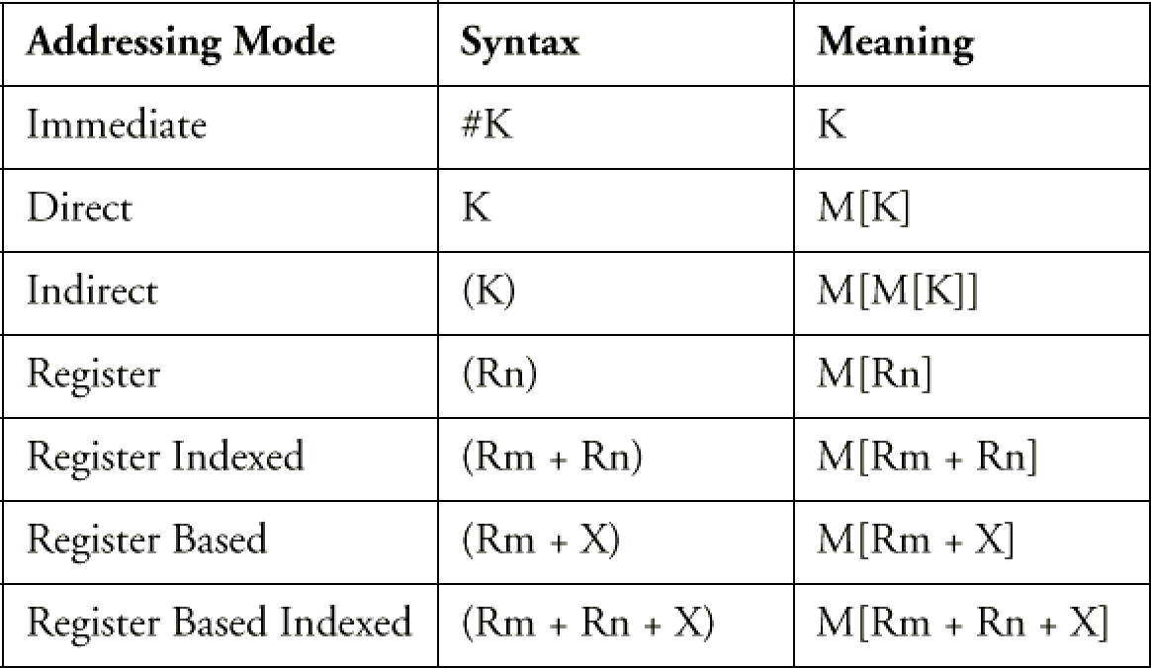
Addressing Modes
  • Four ways of computing the address of a value in memory: (1) a constant value known at assembly time, (2) the contents of a register, (3) the sum of two registers, (4) the sum of a register and a constant. The table gives names to these and other addressing modes.

